Slide 1

Software and hardware control system for the PC monitor external LED backlight

Slide 2
The purpose and objectives of the project
The aim is to develop a prototype of a software and hardware control system for external LED backlight of a PC monitor, which includes a microcontroller as a control device and a mobile application for user interaction with the control device and calculating the cost of electricity consumed.
Для досягнення поставленої мети необхідно вирішити такі задачі:
Consider the types of monitors, the principle of operation, their advantages and disadvantages.
Consider the impact of the monitor on the person as a whole and on their health.
Consider one of the most dangerous shortcomings of human interaction with the monitor - the effect of "black wall".
Consider the technology of dynamic lighting of the monitor, the principle of operation, its advantages and disadvantages.
Based on all the information obtained, consider ways to implement this technology yourself.
Choose the technological platform for the implementation of the control device.
Perform programming of the microcontroller control device and the mobile application, as the user interface and the interacting element with the control device.
Perform layout of the developed prototype of the system and conduct a demonstration experiment.
2
Notes:
Monitor is a device designed to play a video signal and visually display information received from a computer.
The fundamental difference from the TV is the lack of a built-in tuner designed to receive high-frequency signals of terrestrial broadcasting.
The historic beginning in the display of graphic information on the monitor screen occurred in America as part of a military project based on the computer "Whirlwind". The computer was used to record information about the intrusion of aircraft into US airspace.
The next important step in the development of the first monitors was the color image, to obtain which it was necessary to use three electronic beams. Each of them highlighted certain points on the surface of the display.
These monitors have become the most widespread, not only for special purposes, but also in the lives of people who bought the first computers. But the increase in complaints of ill health after eye contact with monitors has provoked much debate about their benefits and harms.

Slide 3
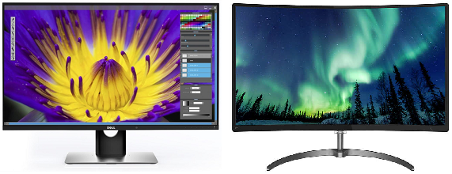
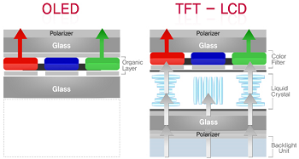
The modern world monitor
Examples
of the modern monitor
Pictorial comparison
OLED and LCD technologies
3
Notes:
According to the type of screen, modern monitors are divided into:
LCD - Liquid crystal display, LCD.
Plasma - based on plasma panel (PDP, gas-plasma display panel).
LED-monitor - on LED technology (Light-emitting diode).
OLED monitor - on OLED technology (Organic light-emitting diode).
LCD technology. Liquid crystal display (LCD) is a flat screen display, electric visual display or video display that uses the modulating light properties of liquid crystals (LCD). LCDs do not emit light directly. They are widely used, including computer monitors, televisions, dashboards, aircraft cabin displays, signs, etc.
They are common in consumer devices such as video players, gaming devices, watches, calculators and phones. LCDs have replaced electron beam displays in most applications. They are available in a wider range of screen sizes than CRT monitors and plasma panels, do not use phosphors, and do not suffer from color fading. LCDs, however, are prone to the "afterglow" effect.
OLED technology. OLED (organic light-emitting diode) is a light-emitting diode (LED) in which the emitting electroluminescent layer of a film consists of organic compounds that emit light in response to an electric current. This layer of organic semiconductor is located between two electrodes, and, of course, at least one of these electrodes is transparent.
Advantages:
excellent viewing angle;
excellent black level. No halo and fast blur due to sub-millisecond response time;
wide range and bright colors due to lack of illumination.
Disadvantages:
may suffer from screen burnout.
organic materials decompose over time, making the display unusable after a while.

Slide 4
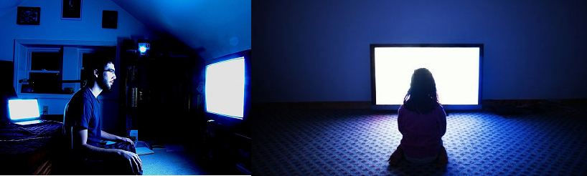
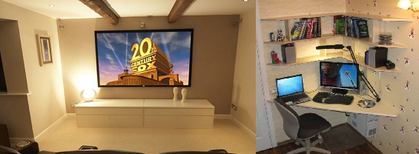
The impact of the monitor on human health
Black Wall effect
«Black Wall effect»
A trivial solution to the problem of effect
4
Notes:
Modern man spends more and more time every year in front of a computer monitor, laptop, TV screen, projector. Manufacturers of information display devices in the fight for their customers are constantly releasing new product lines, lowering prices for their products, each time, according to them, improving its performance. The buyer, in turn, is often no longer able to understand the abundance of models presented and makes the choice more emotionally than rationally, completely forgetting about the impact of the monitor screen on vision and general well-being
The percentage of people who use monitors in the evening and at night for completely different reasons (mode of operation in a different time zone, work on the road, etc.) is growing. Natural light during the day gradually disappears and artificial light sources come to the rescue. Watching TV or playing computer games in the dark is popular, allowing you to admire the impressive story on the screen. After all, there is no cinema where you can watch a movie in the light.
Researchers in New York have shown that watching TV or studying in the dark with other gadgets, including PCs, have a negative effect on eye health. The reason is that the bright screen contrasts with the dark background of the wall or object that is outside the monitor. Such a significant contrast causes eye strain. As a result, they get tired quickly. At the same time the person can feel drowsiness and a headache. After a dark movie, a person's reaction is significantly reduced, which indicates brain fatigue. This was shown by experiments. The cause of headaches and decreased reactions is the increased load on the visual areas located in the brain.
Rapid visual fatigue occurs when the picture changes quickly, when the image is blurred, or when the picture is very bright. Scientists conducted research, conducted a test. One group of people had to watch TV with the lights on and the other with the lights off. So, the second group after a few days spent in front of the TV began to complain of eye fatigue. Ophthalmologists advise watching TV or doing some work on modern gadgets and PCs during the day with the darkening of the room, completely closing the curtains, and in the evening to turn on additional lighting. The main thing is to place the additional lighting correctly so that it is not reflected in the TV or monitor and does not distract the viewer.
Table lamps, chandeliers, sconces and other light sources in the room or in the whole room are used as usual additional (artificial) lighting.

Slide 5
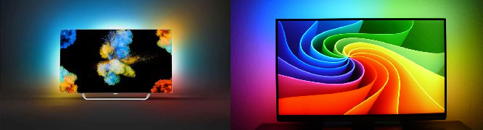
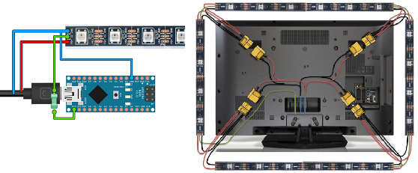
Ambilight technology
Ambilight technology visualization
DIY-Ambilight
5
Notes:
Ambilight (Ambient Lighting Technology) is a backlight technology for TVs invented and patented by Philips Electronics. Is a built-in backlight in LCD TVs, which, analyzing the colors of the image on the TV, reproduces diffused light around the perimeter of the TV. Due to this, the surface of the wall behind the TV body is dynamically illuminated, thus complementing the halo intensity of the image on the screen and creates the effect of visually enlarging the image size.
A significant indicator of this technology is the proof that with such adaptive lighting the eyes are less tired when looking in the dark, thus, without compromising human health and functionality.
The disadvantages of this technology include its use only for TVs and only Philips, the relatively high cost of TVs with this technology (the price of a TV starts at $ 1,000).
The lack of Philips technology in the PC monitor market and the rapid development of the concept of IoT (Internet of Things) has allowed anyone to take advantage of the opportunity to create their own DIY product (Do It Yourself) based on it.
The advantages of such implementations are, first of all, the low cost of the final product, the ability to create a system for a person who lacks even theoretical or basic knowledge in circuitry, physics or electrical engineering and the possibility of using it to play computer games in the evening or no additional lighting.

Slide 6
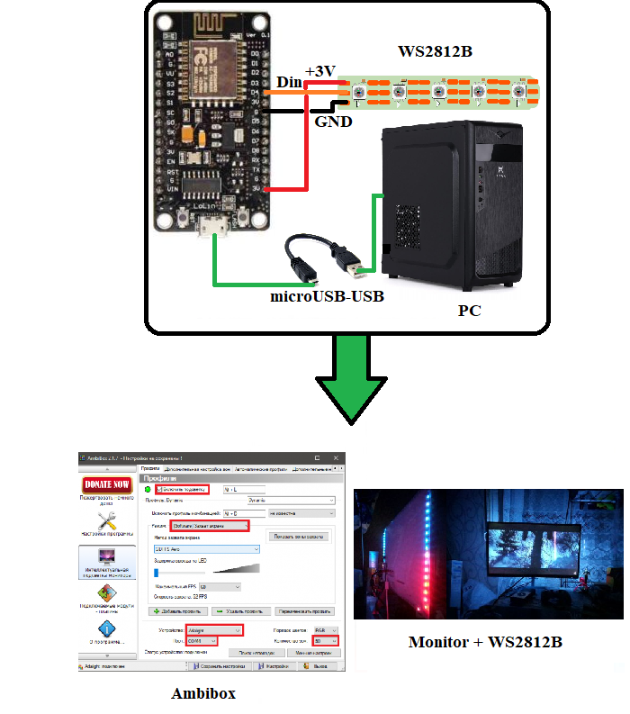
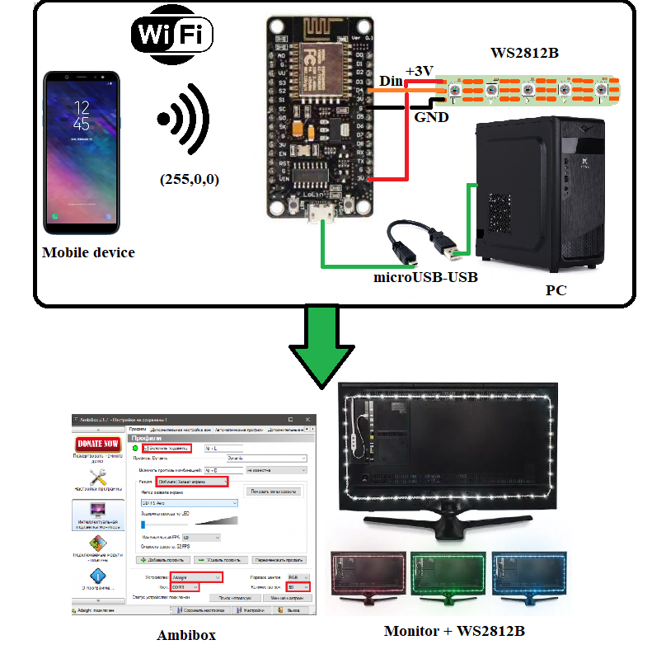
Control device
Schematic implementation of the software and hardware control system for external LED illumination of a PC monitor using UART
Schematic implementation of the software and hardware control system for external LED illumination of a PC monitor using Wi-Fi
6
Notes:
Software and hardware control of the external LED illumination of the PC monitor (MonitorLight) is carried out using a control device (CD), which acts as a microcontroller. The commands to be performed by the user are initiated by the user using software (software) developed by a third-party company and using a mobile application designed and developed for the mobile device. Since the manual and mobile device are manufactured by certain companies and are exclusively the end products of hardware technology, the addition and expansion of their functionality is possible only through software development.
The MonitorLight device helps a person to adjust the backlight of the monitor in the dark when turning off all artificial light sources for one reason or another.
The mobile application transmits to the CP data on the color of the monitor backlight using the Wi-Fi protocol, which is implemented in the microcontroller.
The microcontroller acts as a manual with an internal server for wireless communication of the mobile device and hardware implementation of the system.

Slide 7
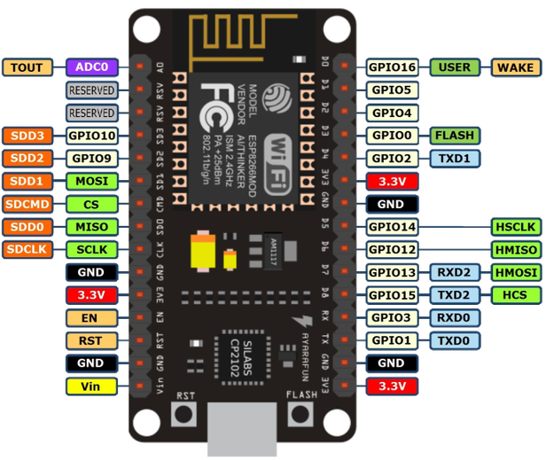
NodeMCU v1.0
Amica NodeMCU V2 module contact description
7
Notes:
NodeMCU is a platform based on ESP8266 for creating various Internet of Things (IoT) devices.
The module is able to send and receive information to a local network or the Internet via Wi-Fi.
An inexpensive module is often used to create smart home systems or Arduino robots remotely controlled.
There are several generations of NodeMCU boards - V1 (version 0.9), V2 (version 1.0) and V3 (version 1.0).
Symbols V1, V2, V3 are used when selling in online stores. There is often confusion in the boards.
For example, V3 is outwardly identical to V2. Also, all boards work on the principle of open-source, so they can be produced by any company.
But Amica, DOIT and LoLin / Wemos are currently producing NodeMCU boards.
The module is equipped with an ESP12-E microcontroller.
All its functional and technical capabilities are preserved and used with additional hardware implementation of the platform (for example, with the control of voltage drop or increase the maximum allowable current).

Slide 8
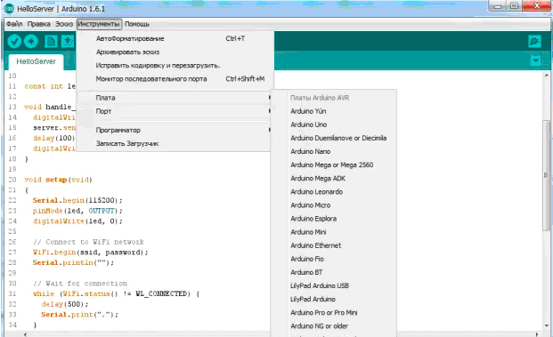
Arduino IDE development environment for ESP8266
The main functions of the development environment
1.Timing and delay. The millis and micros functions return the milliseconds and microseconds, respectively, that have elapsed since the module was started.
2. Serial ports Serial and Serial1 (UART0 and UART1).
3. ESP8266 WiFi Library (ESP8266WiFi).
8
Notes:
Firmware (programming) for the ESP8266 microcontroller is performed using a program in the C programming language in the Arduino IDE.
The Arduino development environment consists of a built-in text editor, a message area, a text window (console), a toolbar with frequently used command buttons, and several menus. To download programs and communication, the development environment is connected to the Arduino hardware

Slide 9
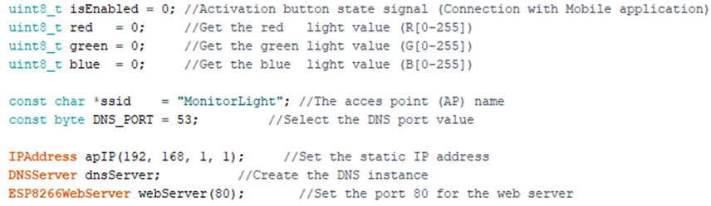
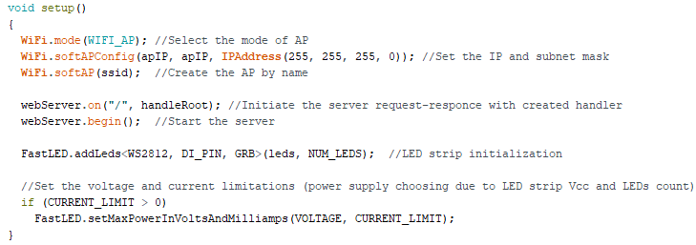
Software code for communication with
Mobile application (1)
9
Notes:
Slides 9-11 show the software implementation of the CP communication with the mobile application in the C programming language in the Arduino IDE development environment.
To start the software implementation of the lighting management system, you need to connect all the necessary libraries
#include <ESP8266WiFi.h> / * Connecting a library for wireless connection to a mobile device * /
#include <DNSServer.h> / * Library for setting up data transfer between mobile device and MCU * /
#include <ESP8266WebServer.h> / * Library for receiving data from the mobile device and their further processing * /
Variables and mobile and interoperability objects help the developer to have all the information about the server and save the data received from the mobile application. It's also a good style of describing code, so as not to use "magic numbers" and its constant duplication.
To start the server, create and enable a wireless access point, you must create a mandatory setup () procedure, which, by its nature, must keep all the primary settings of the required components in the initial state (ie in the state of first start or start).

Slide 10
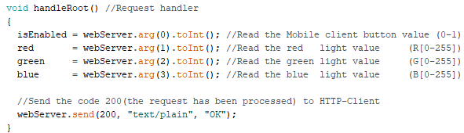
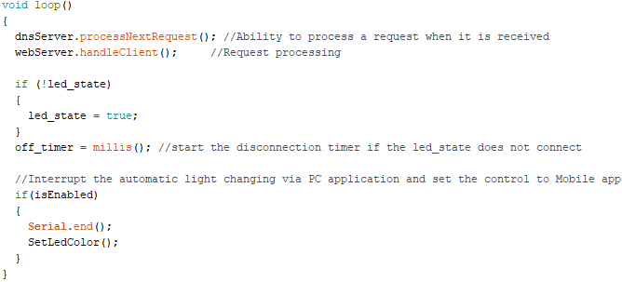
Software code for communication with
Mobile application (2)
10
Notes:
When interacting with the mobile device and the configured network, the data sent from the mobile application must be received and processed in a way that will be perceived by the software implementation (in the form of objects, integers, etc.). To do this, you need to create a request handler, which will act when you receive data to the server with the specified IP address.
For continuous execution of code with all additional requirements and functions, it is necessary to implement the loop () procedure, which contains server functionality for continuous server operation and the ability to call the request handler when it is sent (i.e., switch access to external peripherals from PC to mobile application ).

Slide 11
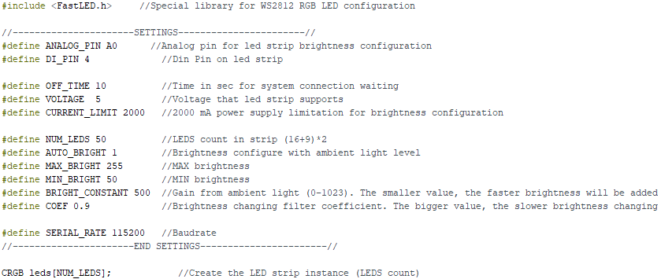
Software code for work with LED strip (1)
11
Notes:
It is necessary to create a declarative part, which contains information about the foam to which the LED strip is connected, the number of LEDs, their brightness, number of colors and a standard delay of one second, which notifies the user about the color on the ribbon.
Also, a convenient way is to declare the necessary colors for more compact storage. The Color function (int g, int r, int t) combines colors in G-R-B gradation into one 32-bit number, which is convenient to use when transferring it to other parts of the code.

Slide 12
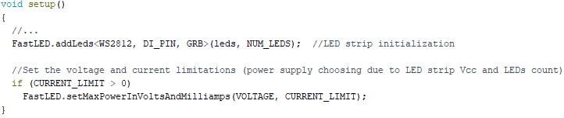
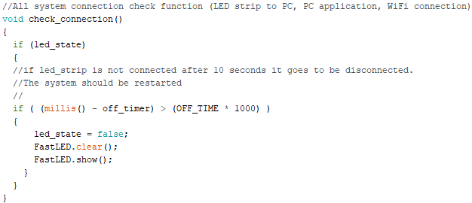
Software code for work with LED strip (2)
12
Notes:
For the standard settings of the LED strip (brightness and color), as well as its activation, it is necessary to create a mandatory procedure setup (), which, by virtue of its purpose, should keep all the primary settings of the required components in the initial state. ). FastLED is a fast, efficient, easy-to-use Arduino library for programming address LED strips and pixels such as WS2810, WS2812B, LPD8806, Neopixel and more. FastLED is used by thousands of developers, in numerous art and hobby projects, as well as in numerous commercial products.
In addition to fast, efficient, compatible LED driver code, FastLED also provides features that provide fast animation:
full support for classic RGB;
basic brightness adjustment (with monitoring of critical situations from the power supply of the tape) controls the brightness, power consumption and battery life.
For an accepted and good tone of programming, if there is a situation that leads to duplication of the same code, it is necessary to make its implementation in a separate block of code that has only one description, but can be performed in different places with the necessary parameters. , or without them. Depending on the result to be displayed in the part of the software implementation where it is needed, such a block of code is called a function or procedure. The difference between them is in the same result of execution. The function returns the result as a specific data type (integer, character, etc.), and the procedure performs an operation or operations without returning the result (void).
There are 2 such blocks of code in the MonitorLight software implementation in the form of the check_connection () procedure and the SetLedColor () procedure. The role of the first is to check the connection between the PC and the LED strip. If the connection does not take place within 10 seconds, the system goes into standby mode, turning off the LED strip until the next time of connection. The call for these functions is shown on the next slide.

Slide 13

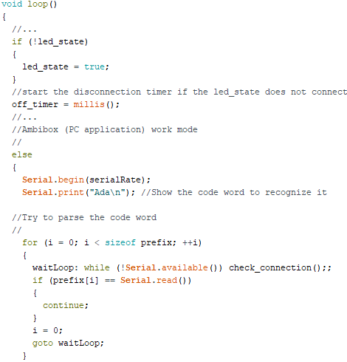
Software code for work with LED strip (3)
13
Notes:
For the standard settings of the LED strip (brightness and color), as well as its activation, it is necessary to create a mandatory procedure setup (), which, by virtue of its purpose, should keep all the primary settings of the required components in the initial state. ). FastLED is a fast, efficient, easy-to-use Arduino library for programming address LED strips and pixels such as WS2810, WS2812B, LPD8806, Neopixel and more. FastLED is used by thousands of developers, in numerous art and hobby projects, as well as in numerous commercial products.
In addition to fast, efficient, compatible LED driver code, FastLED also provides features that provide fast animation:
full support for classic RGB;
basic brightness adjustment (with monitoring of critical situations from the power supply of the tape) controls the brightness, power consumption and battery life.
For an accepted and good tone of programming, if there is a situation that leads to duplication of the same code, it is necessary to make its implementation in a separate block of code that has only one description, but can be performed in different places with the necessary parameters. , or without them. Depending on the result to be displayed in the part of the software implementation where it is needed, such a block of code is called a function or procedure. The difference between them is in the same result of execution. The function returns the result as a specific data type (integer, character, etc.), and the procedure performs an operation or operations without returning the result (void).
There are two blocks of code in the MonitorLight software implementation in the form of the check_connection() procedure and the SetLedColor() procedure. The role of the first is to check the connection between the PC and the LED strip. If the connection does not take place within 10 seconds, the system goes into standby mode, turning off the LED strip until the next time of connection. The call for these functions is shown on the next slide.

Slide 14
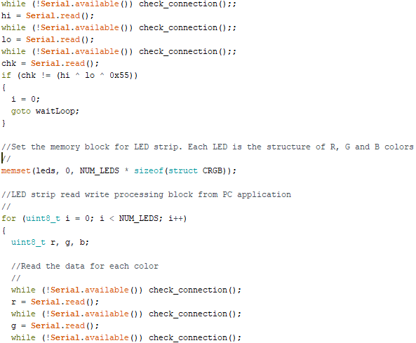
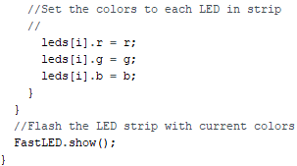
Software code for work with LED strip (4)
14
Notes:
For continuous and continuous code execution with all additional requirements and functions, it is necessary to implement the loop() procedure, which includes the main function of the MonitorLight system - displaying colors from the image on the monitor on the LED strip at the current time.

Slide 15
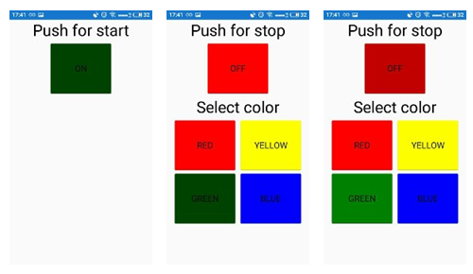
Mobile app GUI
The main type of application, turn on the system, change the color of the LED backlight and turn off the system
15
Notes:
The mobile application (client) contains 2 text fields and 5 buttons. The main element of the application is one of the buttons, which when pressed sends a request to the server (created on the microcontroller ESP8266 (NodeMCU module)), notifying him of the launch of the mobile application, setting up communication between mobile device and KP, enabling wireless network and change its color.
The upper text box (Push for start / Push for stop) is a hint when to press the button to turn on the system and when to turn it off.
The Select color text box tells the user that pressing the multi-colored buttons is a remote control for external LED lighting, implemented in a mobile application.
When the system is turned off, the GUI changes and prevents the user from switching ribbon colors while the wire protocol is running. When the system is turned on, access to the wireless network is present, and data transmission over the wire "falls asleep".
The interface of the mobile application is designed in the XAML layout language.

Slide 16
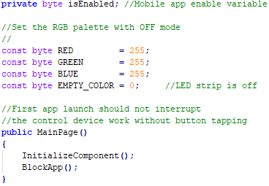
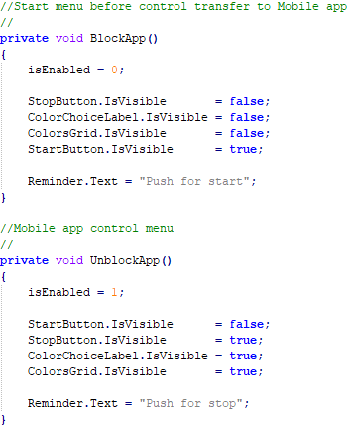
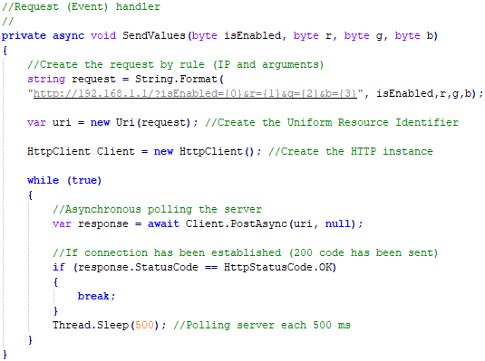
Mobile app code(1)
16
Notes:
Pressing the button (turning the system on and off) and changing the time value with a stepper is done using event handlers in the C # programming language in the Visual Studio programming environment. Event handlers are also a trigger for changing the graphical user interface and generating a request based on a button press and the corresponding delay time set by the user.
isEnabled, EMPTY_COLOR, RED, GREEN, BLUE are class fields that store system on / off values ​​and colors to exclude "magic" numbers. That is, to exclude all possibilities of programming numbers in their explicit form (for example, instead of the variable isEnabled in each event handler enter 0 or 1, depending on the state in which we need to enter the system). The byte data type indicates that each field can have 256 integer values ​​(0..255).
Execution of event handlers each time causes the procedure of forming and sending a request to the MCU. This is a procedure that has a special mode of operation. It should only run in asynchronous mode (as indicated by the async keyword when declaring it and the await keyword when sending a request to the server) and continuously until a positive response is received from the server (code 200 with the text message " OK").
Continuity is realized by means of an infinite loop while (true) {…}.
But constantly sending requests to the server can completely disrupt its work and lead to its "failure" (a mechanism very similar to the well-known DDoS attack).
The procedure is executed asynchronously, which indicates the need to create another thread of program execution. If you "sleep" the stream that is allocated to it, the "fall" of the server is excluded. The way to "sleep" the stream is to set a delay each time a request is made. The optimal delay is 300-500 milliseconds.

Slide 17
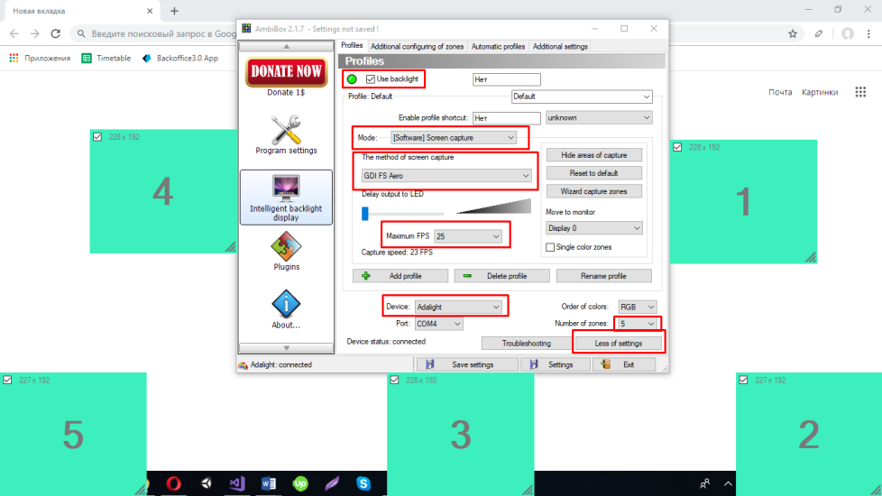
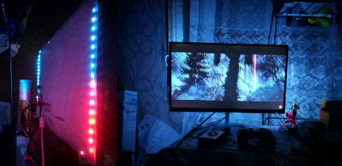
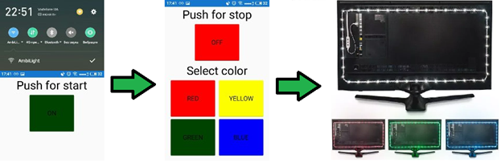
  Demonstration experiment
Initial settings
The operation mode of the system on the wire
The operation mode of the system for
wireless data transmission
17
Notes:
The system starts when the manual is connected to a PC using a microUSB-USB (return to slide 5).
Next, you need to install the Ambibox program, which is the link between the manual and the PC to display colors on the LED strip and make the initial settings.
It is not necessary to connect the mobile device to the manual when the system is operating in wired data mode.
It is enough to wait until the program restarts, which means that all settings are saved and it is activated automatically until the manual is disconnected from the PC or the intermediary program (Ambibox) is completed.
When the system is operating in wireless data mode, you need to connect the mobile device to the access point, turn on the mobile application and press the "ON" button. In this case, the data transmission over the wire "falls asleep" and the user controls the LED backlight only with the help of a mobile application. In this case, the intermediary program must be enabled in order not to confuse all the settings of the LED strip. Also, it is worth noting that the LED backlight has one color.
Pressing the "OFF" button turns off the wireless mode. The system returns to the wired connection.

Slide 18
Conclusions
A prototype of a software and hardware control system for external LED backlight of a PC monitor using a hardware platform based on a microcontroller device and a client-server part, based on a mobile application on the Android platform.
The control device is based on the microcontroller ESP-12E (ESP8266) with Wi-Fi module NodeMCU. The microcontroller is programmed in the С programming language in the Arduino IDE using the standard description of the software implementation in this IDE.
The mobile part of the system is implemented on the Android platform in the C # programming language using Xamarin and XAML technology, as a GUI layout.
The layout of the outdoor lighting control system is implemented on the basis of a simplified circuit implementation using LED strip based on WS2812B LEDs.
18

